Slide 1
聖哉 聖哉 聖哉 聖哉 聖哉 聖哉 聖哉 聖哉...
Holy, holy, holy, holy
Holy, holy, holy, holy...

Slide 2
聖所的幔子已經裂開
帶著羔羊寶血近前來
稱謝讚美 直到永遠
與基督藏在神的裡面
坐在高天瞻仰祂容顏
聆聽主心 傳祂旨意
Now the temple veil in two has split, And the blood of Christ for all has flowed: Glory, honor, worship and praise! Now my life with Christ in God is hid, And my God in heaven I'll behold, Know His goodness, tell of His ways!

Slide 3
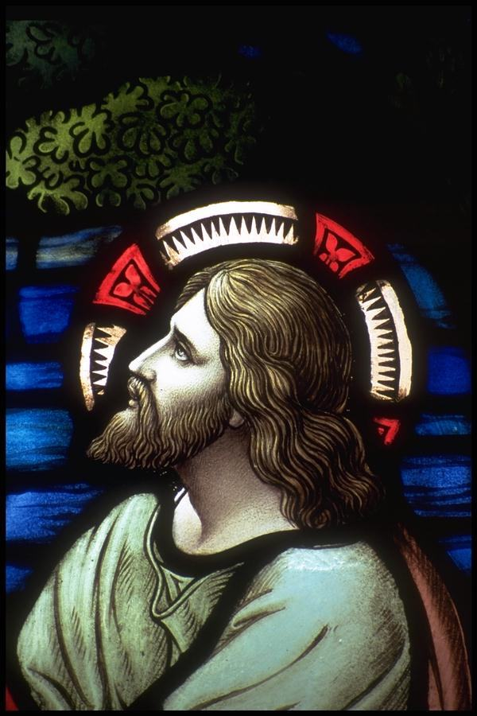
興起啊 君尊的祭司
興起啊 聖潔的國度
在萬邦宣揚祂的榮美
向萬代傳揚祂的作為
Rise up, a nation of our God! Rise up, a priesthood of our King! Forever His mighty deeds proclaim Declaring the the glory of His name!

Slide 4
聖哉 聖哉 聖哉 聖哉 聖哉 聖哉 聖哉 聖哉...
Holy, holy, holy, holy
Holy, holy, holy, holy...

Slide 5
聖所的幔子已經裂開
帶著羔羊寶血近前來
稱謝讚美 直到永遠
與基督藏在神的裡面
坐在高天瞻仰祂容顏
聆聽主心 傳祂旨意
Now the temple veil in two has split, And the blood of Christ for all has flowed: Glory, honor, worship and praise! Now my life with Christ in God is hid, And my God in heaven I'll behold, Know His goodness, tell of His ways!

Slide 6
興起啊 君尊的祭司
興起啊 聖潔的國度
在萬邦宣揚祂的榮美
向萬代傳揚祂的作為
Rise up, a nation of our God! Rise up, a priesthood of our King! Forever His mighty deeds proclaim Declaring the the glory of His name!

Slide 7
興起啊 君尊的祭司
興起啊 聖潔的國度
在萬邦宣揚祂的榮美
向萬代傳揚祂的作為
Rise up, a nation of our God! Rise up, a priesthood of our King! Forever His mighty deeds proclaim Declaring the the glory of His name!

Slide 8
聖哉 聖哉 聖哉 聖哉 聖哉 聖哉 聖哉 聖哉...
Holy, holy, holy, holy
Holy, holy, holy, holy...

Slide 9
聖所的幔子已經裂開
帶著羔羊寶血近前來
稱謝讚美 直到永遠
Now the temple veil in two has split, And the blood of Christ for all has flowed: Glory, honor, worship and praise!

